Slide 1
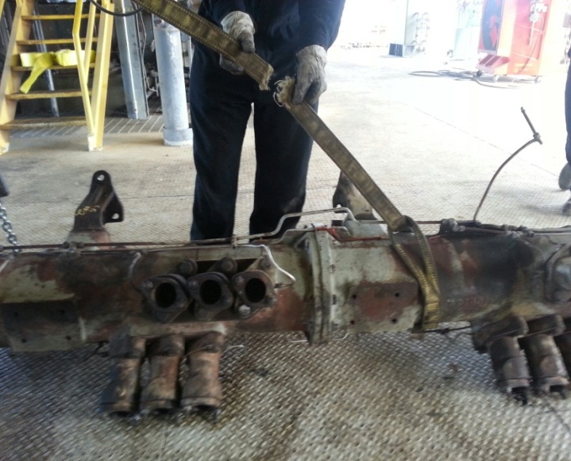
HS&E INCIDENT BULLETIN |  | 2nd half year 2014
U.S. | Type of incident - Dropped Load
Summary:
A crew was lifting a cam-box/camshaft housing from the top of a gas engine using a two-leg configuration. An employee was standing on top of the V-block assisting with rigging and as he was making his way down from the V-block, one of the nylon slings failed causing the cam-boxes to drop 3”-5”. The cam-box rolled onto the employee’s foot.
Root Causes: | Actions Taken Thus Far: Next Steps
Line-of-fire not identified, sling failure. | Eliminate use of client rigging, establish safe working zone to avoid potential line-of-fire, establish documented rigging control

